Slide 1

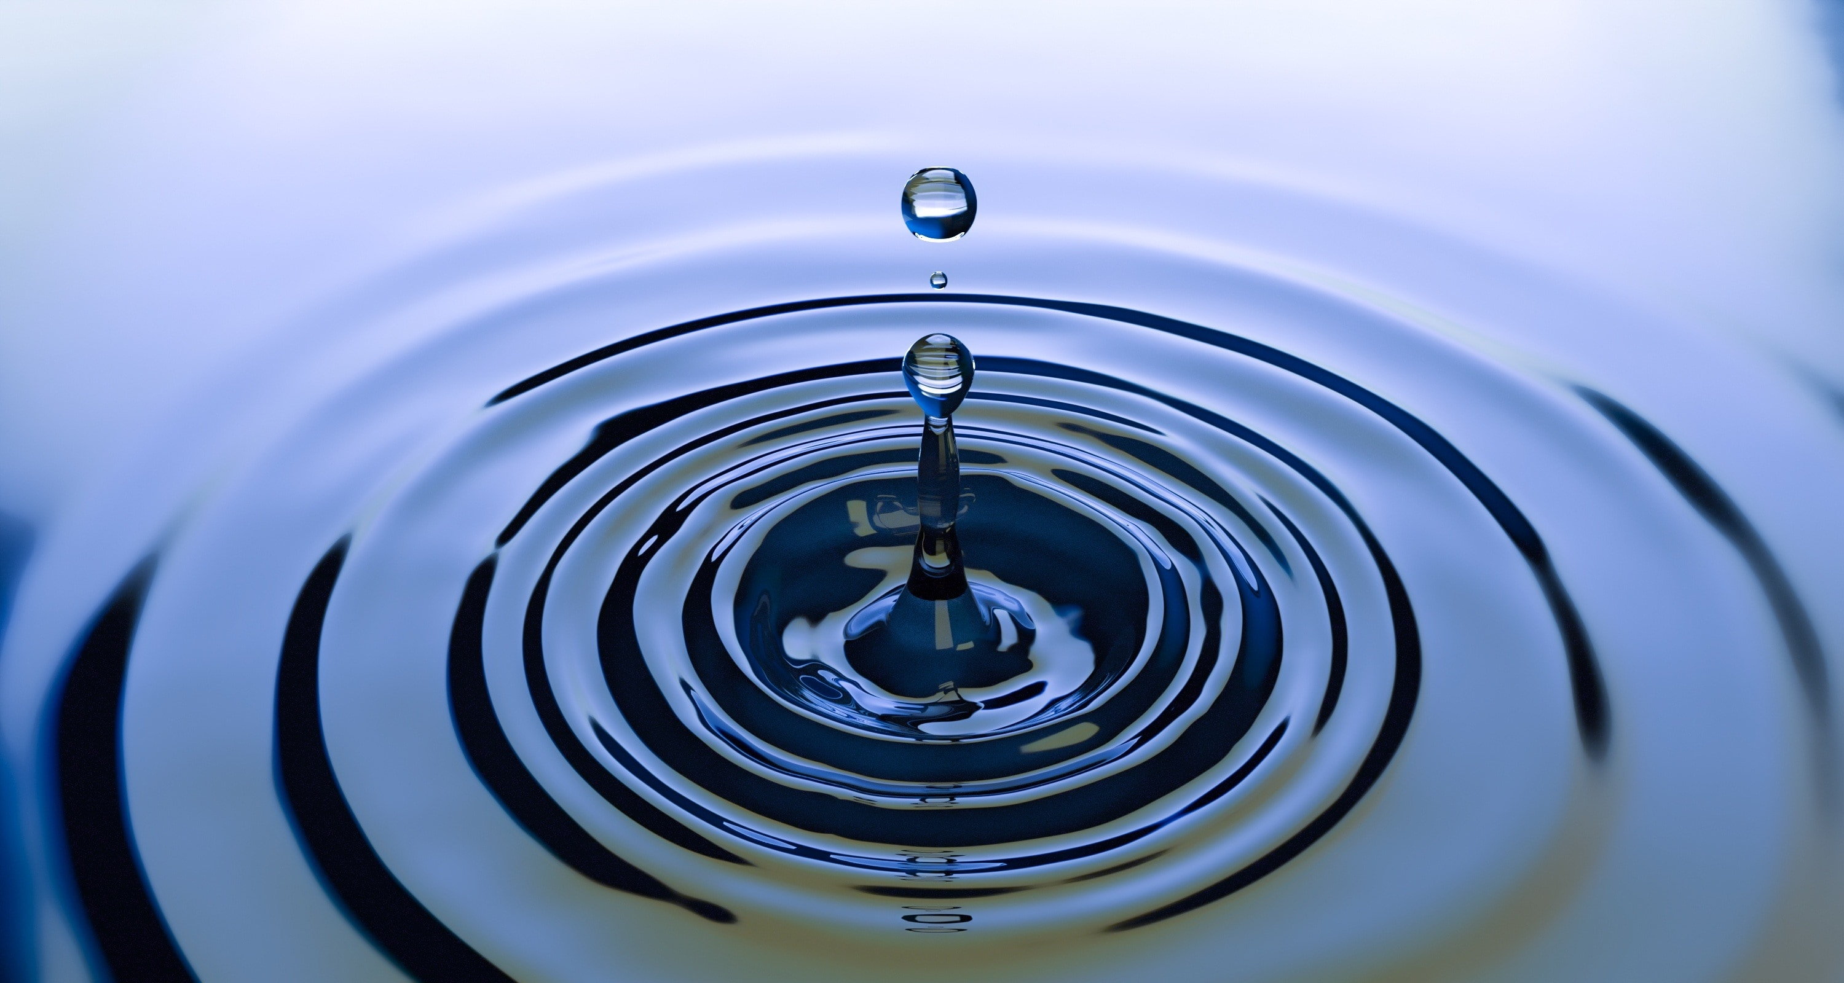
A comprehensive look at water monitoring stations and their locations
Water Stations in California
Bhagi Laksumanage
Noah Woltman
Jarvis Cathey

Slide 2
Introduction
Comprehensive analysis of water monitoring stations across California that are geographically dispersed.
Studied four different types of water stations. i.e. Surface Water, Ground Water, Water Quality, and Tide stations
Data obtained from the water board of California which is an open source site
Limited the Data set to the State of California for convenience of data gathering purposes
Purpose and Usage of Analysis: For water supply of crops for Farmers etc, and government entities such as the EPA(environment Protection Agency) could use this analysis for water quality measurement etc.
Used two data sets for our analysis –Data set 1 - Consists of 1115 records
Our visiualizations include a Geo Spatial Map(built using Java Script, Html, Css and Flask app), A bar chart using Matplotlib and an interactive map using Bokeh library.
A K means clustering analysis is also performed using the geo coordinates.

Slide 3
Extract, Transform, & Load “ETL” Process
We extracted the data from the following open source site: https://www.waterboards.ca.gov/resources/data_databases/
The data was available on the site as csv files.
We used two different data sets.
Both data sets consisted of water station types, the county, latitude, longitude etc.
Data set 1 was used for the Geo Map and the Bar chart and data set 2 was used for Noah’s chart.
For data set 1, the data was cleaned by dropping two columns that had a large number of null values and in the remaining columns the null values were dropped and our final data count was 1115.
Used SQLAlchemy to directly connect to the PostgreSQL database via ORM and the corresponding table was created the data was imported via sqlalchemy.

Slide 4
ETL Process cont’d
To Integrate PosrgreSQL and Python - used a PostgreSQL adapter called Psycopg2(which needed to be installed through pipinstall)
After the data import we had to make an adjustment to the column types as the the columns were imported as text columns via SQl alchemy.
After we altered the column types we exported the cleaned data as a csv file to plot the charts.

Slide 5
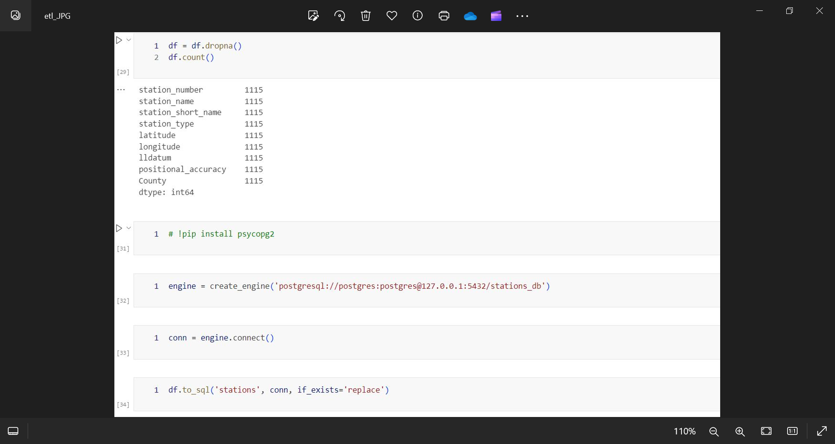

Slide 6
Design & Creation of the Map
We used flask backend with interactive API routes
CSS file - Style
Html file - To create and build website
Java script – To create and build website
Flask - App.py - Used it to load the data by converting csv to Jason and making a call to the html file to be rendered
Created a drop down so we can filter the data on the map by water stations
Color coded the different station types
Used pop up markers with station type, station name & county
Used Java sript and leaflet for filtering and creating markers

Slide 7
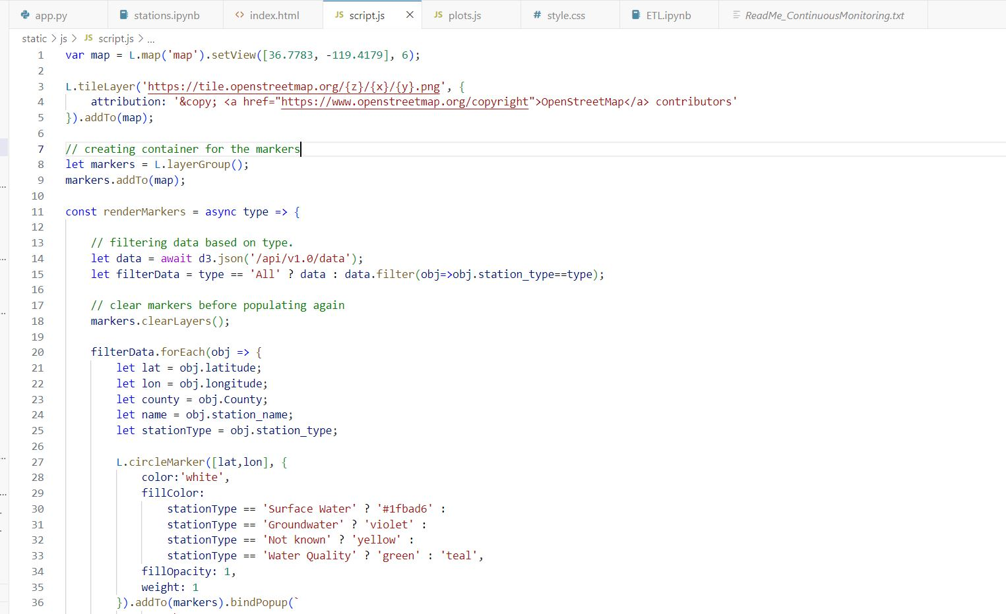

Slide 8
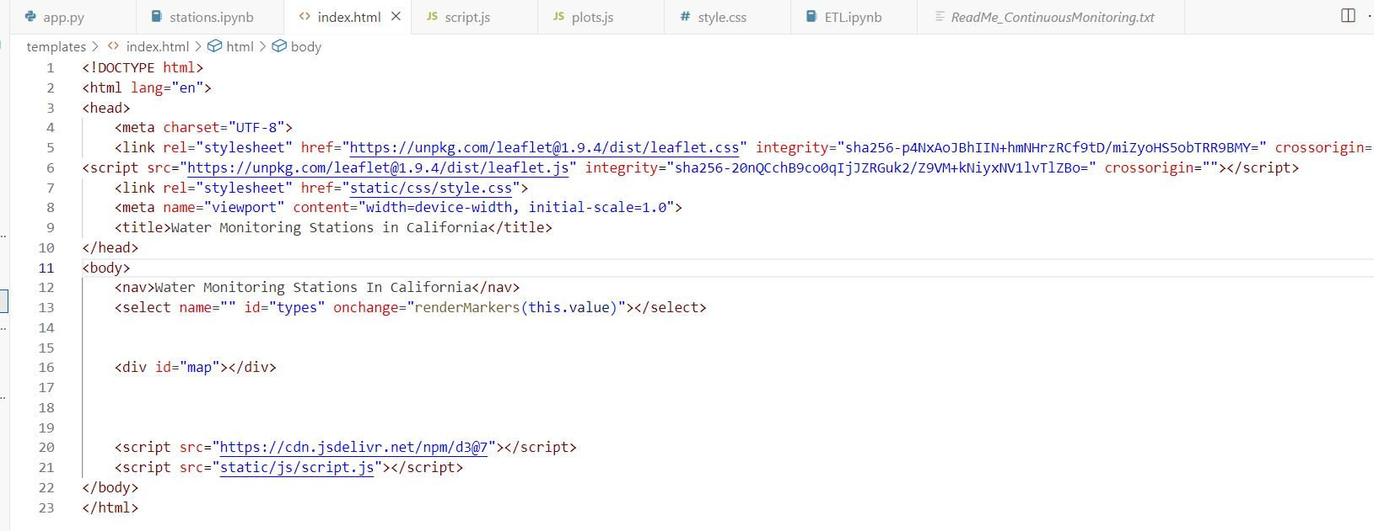

Slide 9
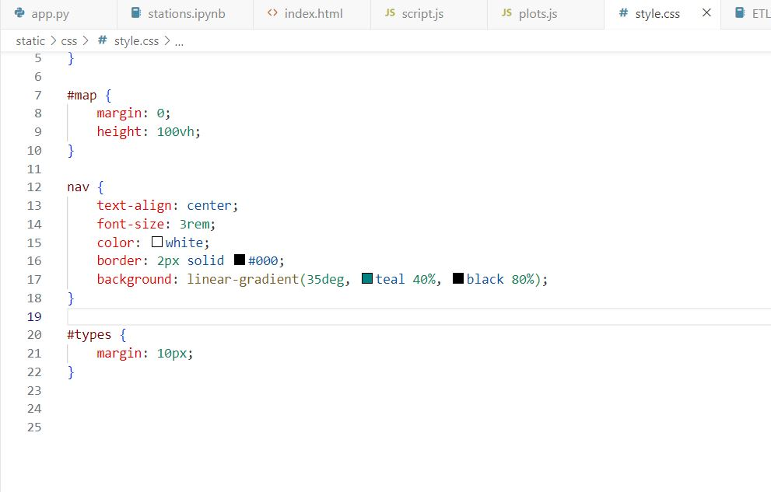

Slide 10
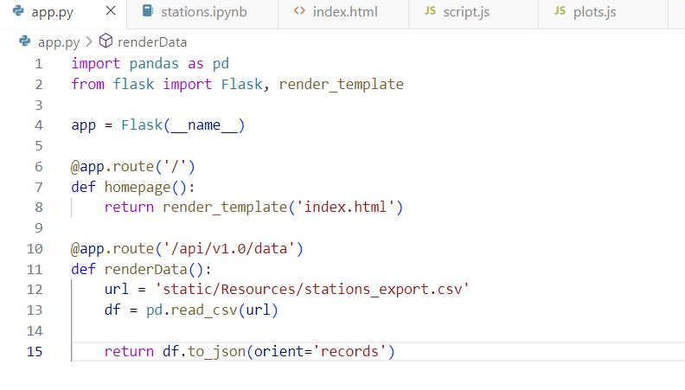

Slide 11
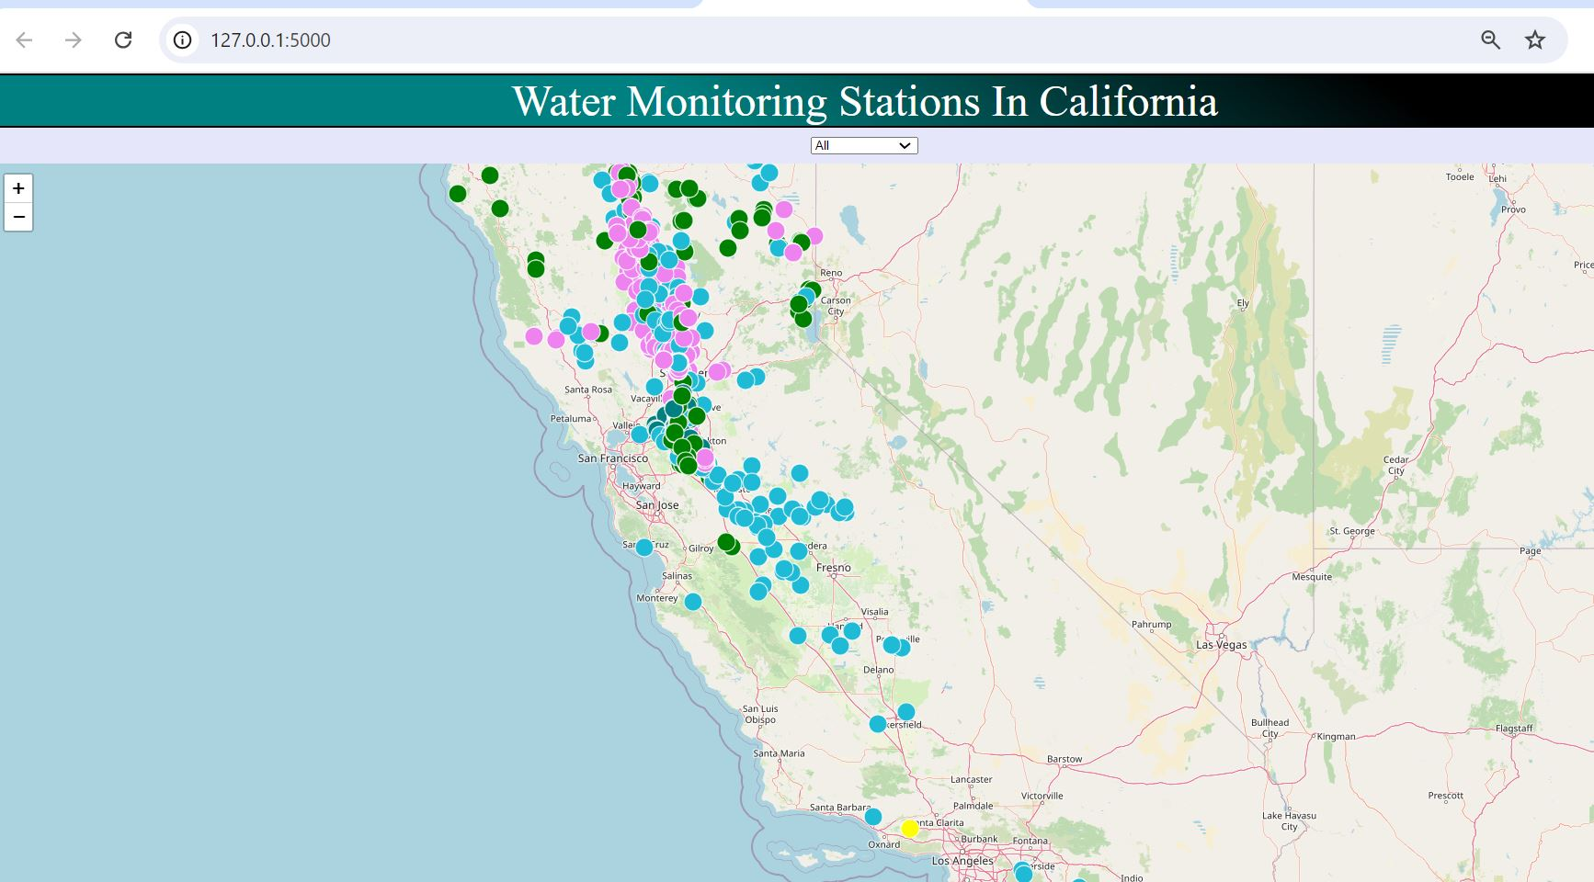

Slide 12
Bar Chart Visualization
Created a bar chat to represent the number of stations by county.
Chart Features
Total number of counties were represented
Y-axis range from 0 to 140 stations.
Bars colored in sky blue for clarity.
X-axis labels rotated at 90 degrees for better readability.

Slide 13
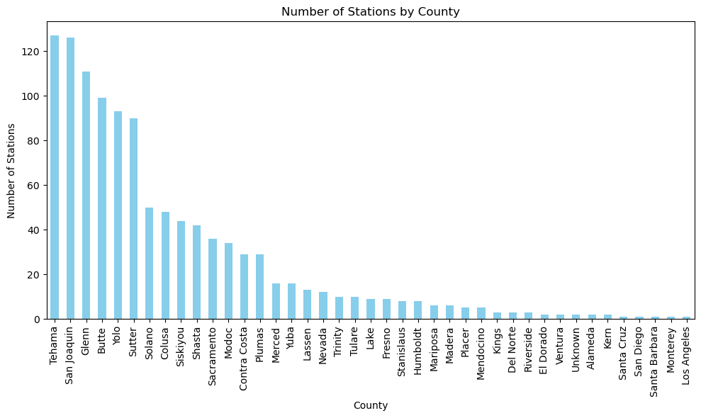
Bar Chart of Stations by County

Slide 14
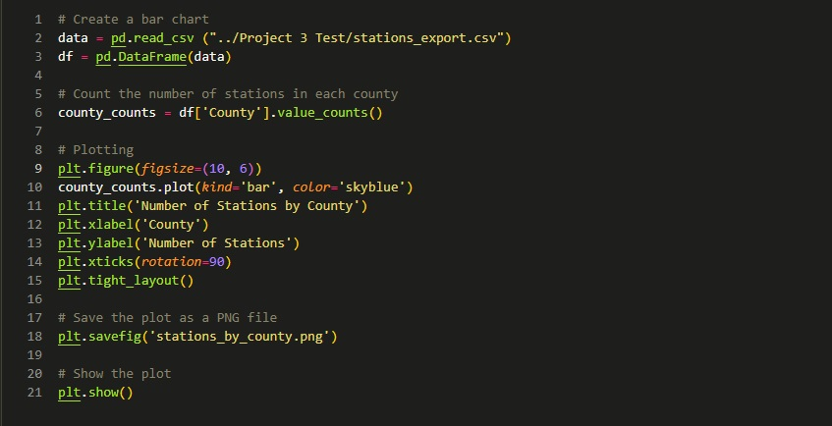
Bar Chart Syntax

Slide 15
Insights from the Bar Chart
Key Observations:
Counties with the highest and lowest number of stations are identified
There are potential reasons for discrepancies in stations counts (e.g., population density, geographic size)
Implications:
Understanding the distribution can inform resource allocation and monitoring strategies

Slide 16
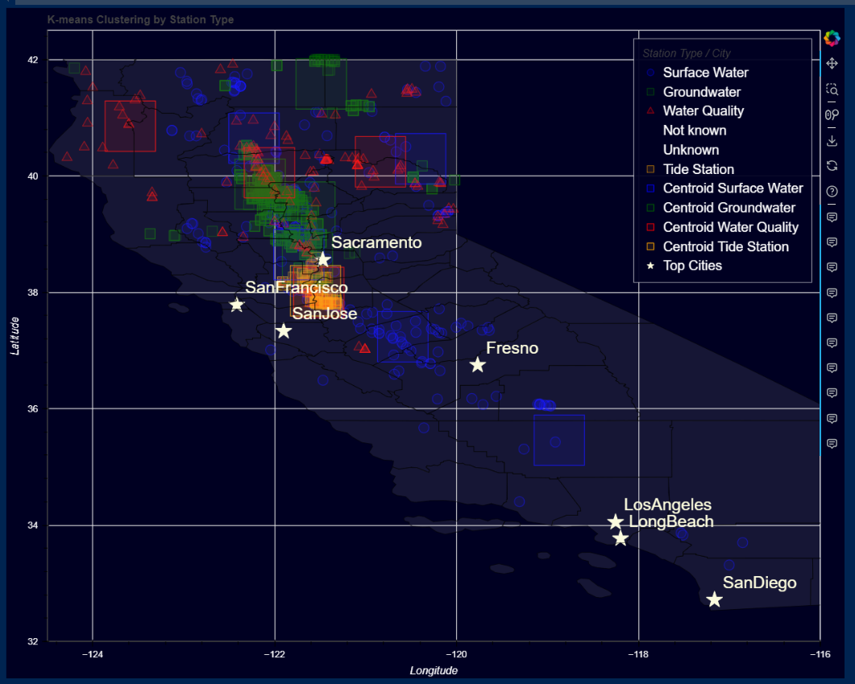
Bokeh and Kmeans Insights
Key Observations:
We explore Bokeh, a new data visualization library, and create K means clusters to investigate clustering behaviors for station types.

Slide 17
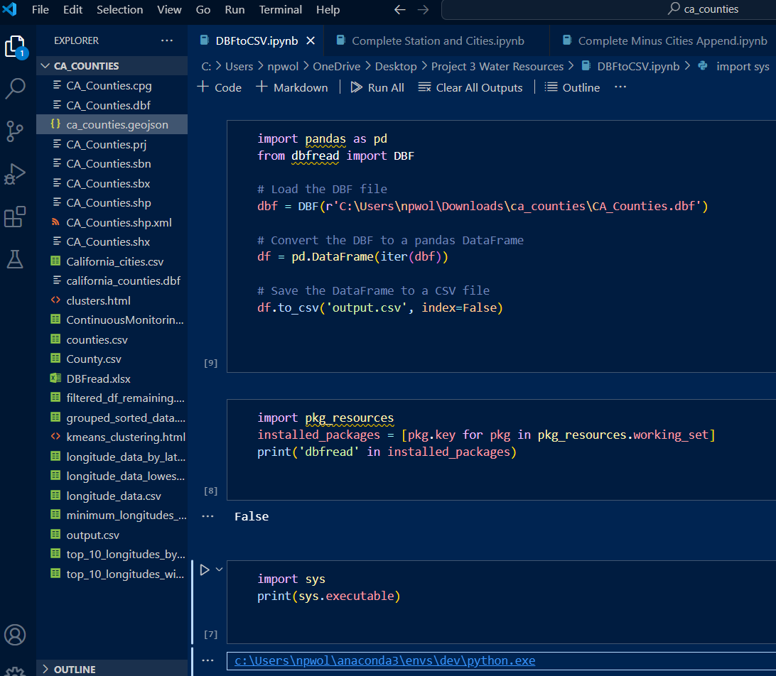
DBFread

Slide 18
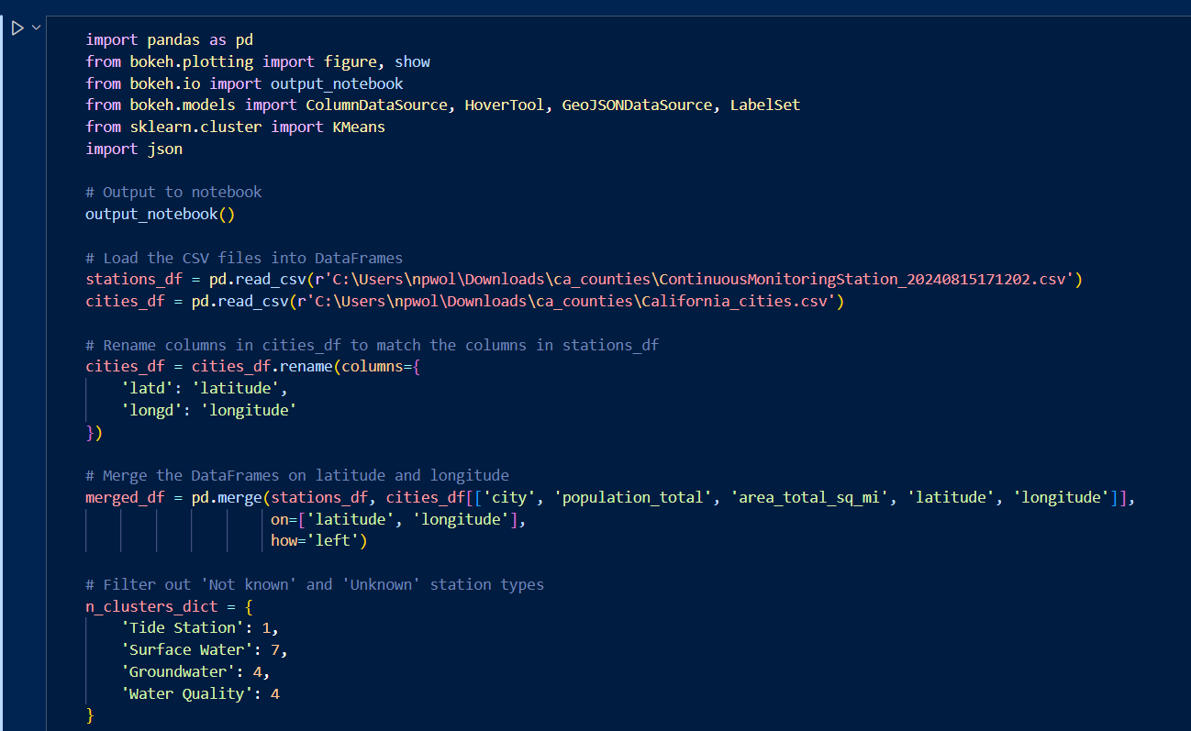
Uploading and Cleaning

Slide 19
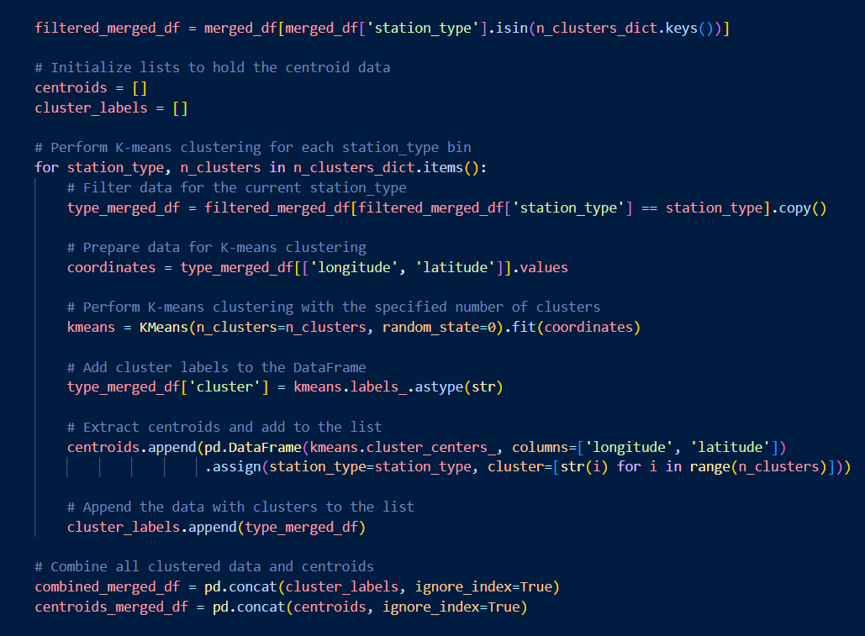
Kmeans Clustering w/Sklearn

Slide 20
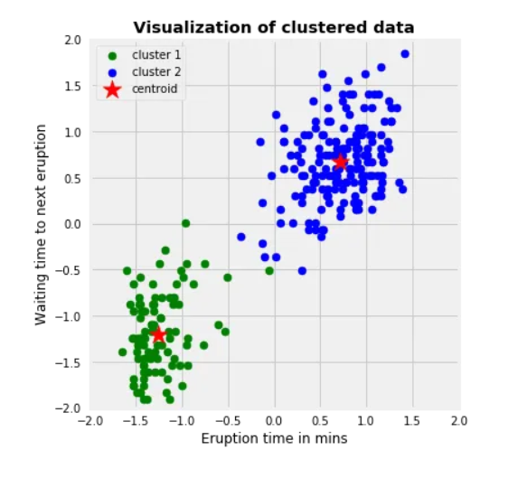
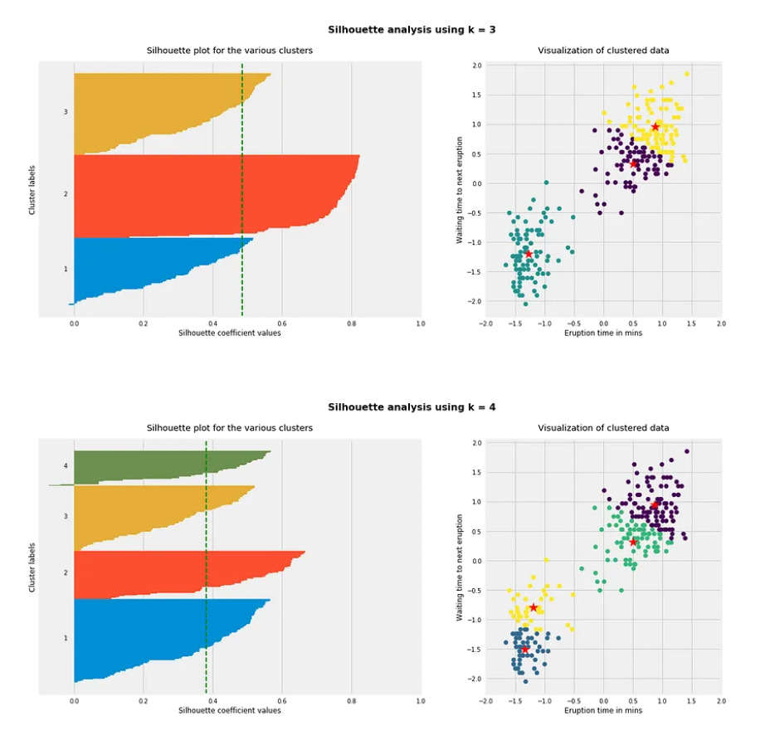
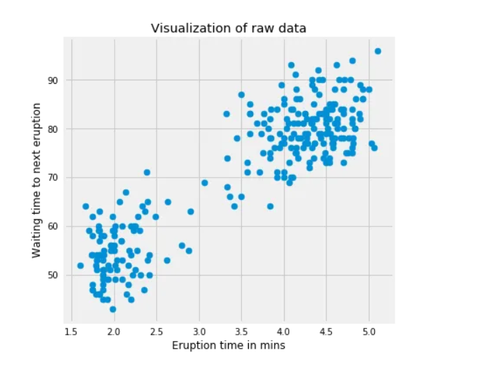
K Means

Slide 21
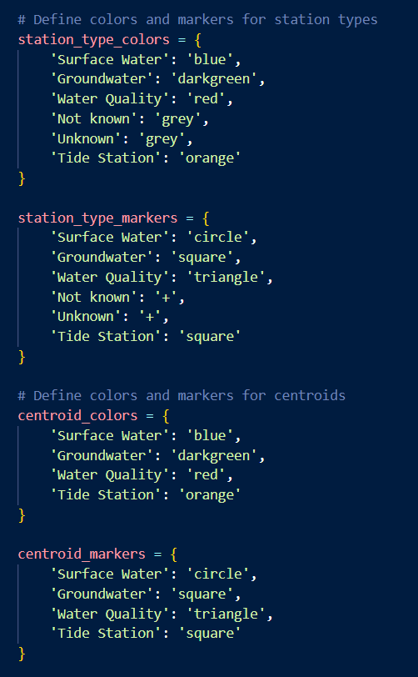

Visual Formatting

Slide 22
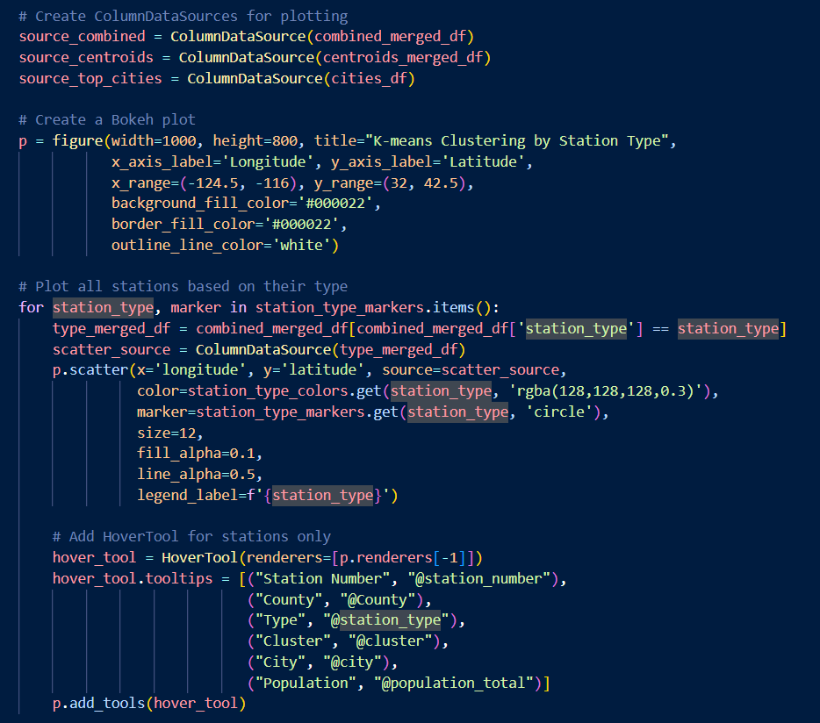

Plot Stations
Bokeh Plot
Hover Tools

Slide 23
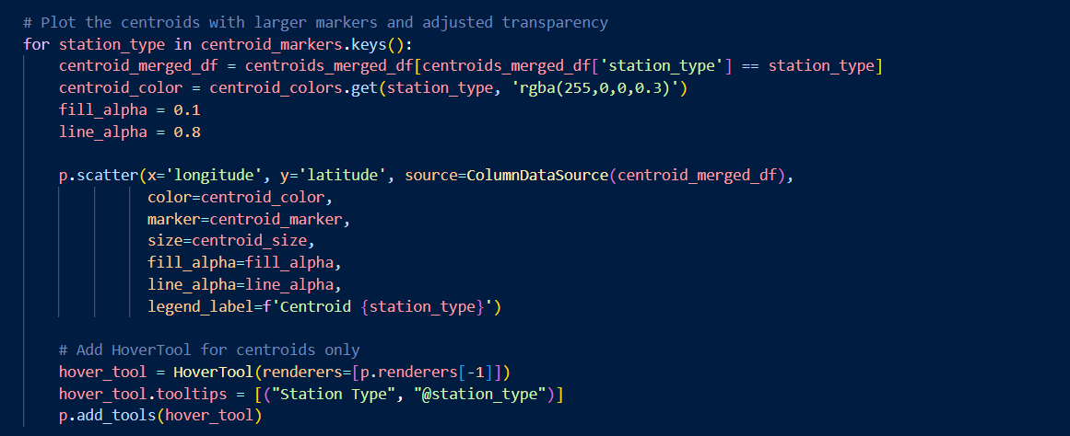
Plot Kmeans Cenroids

Slide 24
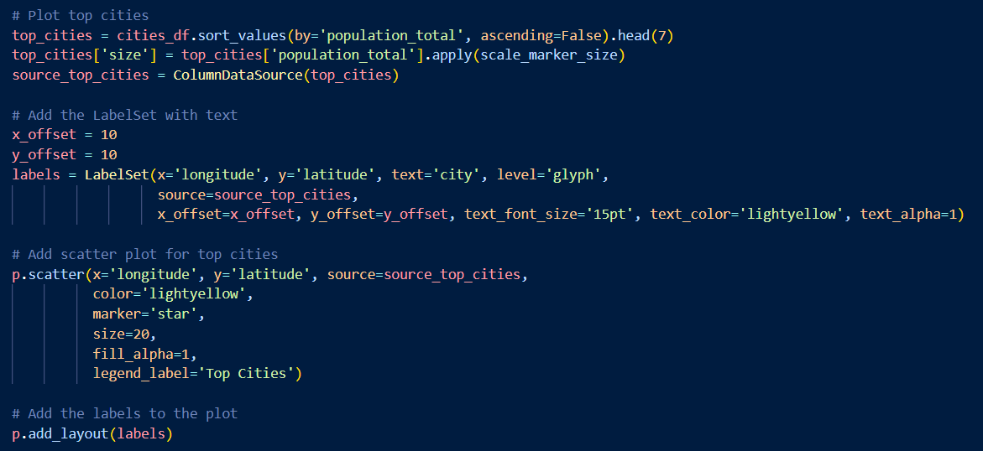
Plot Cities

Slide 25
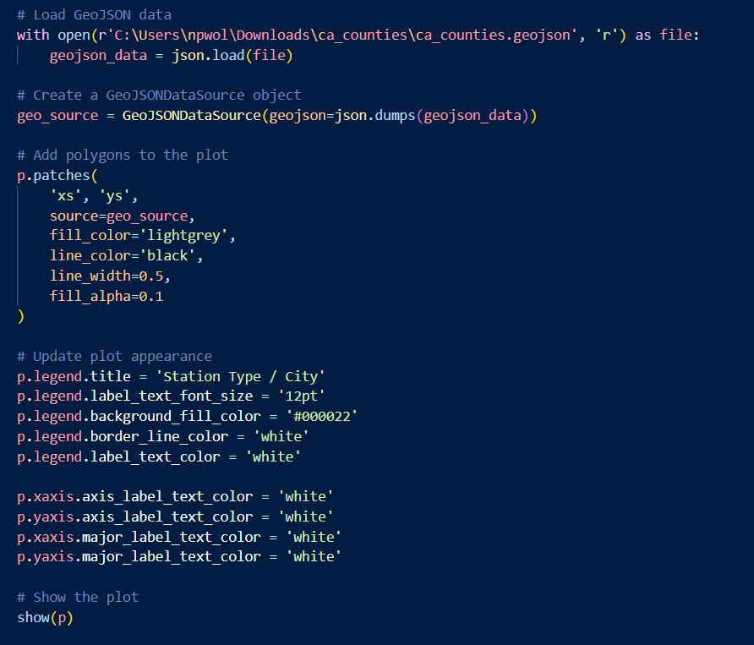
County Boundaries & Final Formatting

Slide 27
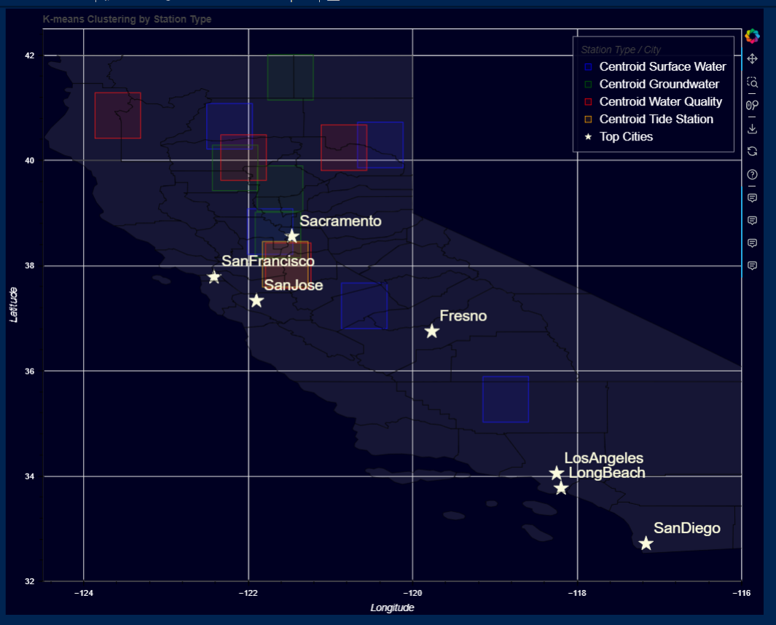

Slide 28
Summary
In summary, the datasets published by the WDL are instrumental in fostering a deeper understanding of water quality and groundwater dynamics. By merging and analyzing the data through clustering and visualizations, and offering interactive features via a web app, our project provides a comprehensive view of water monitoring stations in California, aiding in understanding distribution patterns and resource planning.

Slide 29
Questions?

